Slide 1
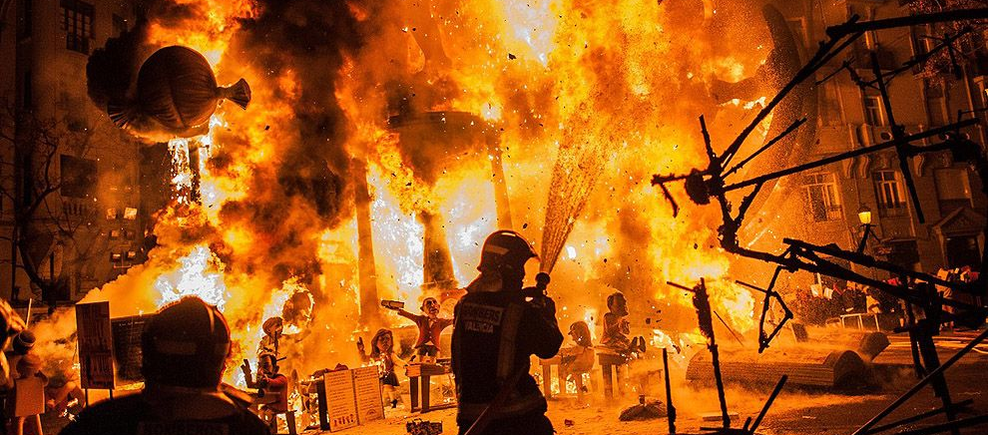
FIRE PROTECTION

Slide 2

INTRODUCTION
Fire protection is the practice of preventing, controlling, and reducing the impact of fires on people, property, and the environment.
It involves designing, installing, and maintaining systems and measures to stop fires from starting or spreading and to safely manage them when they occur.

Slide 3
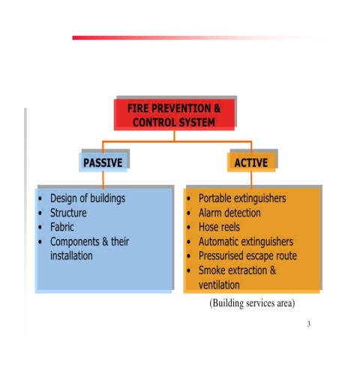

Types of FIRE PROTECTION

Slide 4
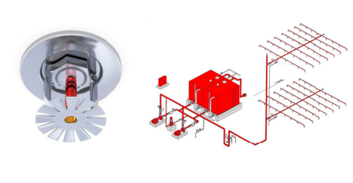
sprinkler
Purpose:
A device that sprays water.
An automatic fire extinguisher installed in the ceilings of a building

Slide 5
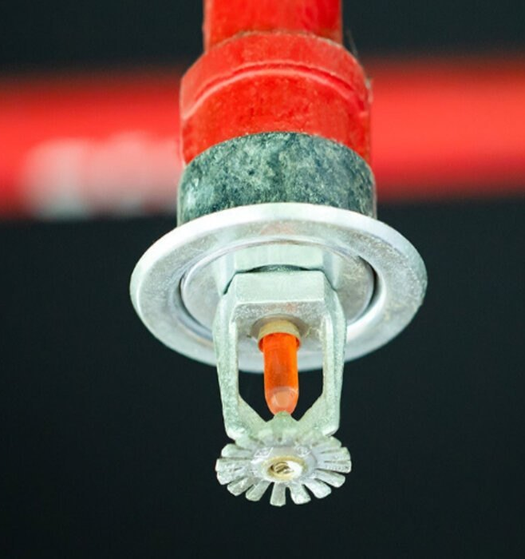
Selection PARAMETERS OF SPRINKLER
Mounting of sprinkler head
Temperature rating
K Factor
Standard response & Quick response
Open type & Automatic type
Standard Coverage & Extended Coverage

Slide 6
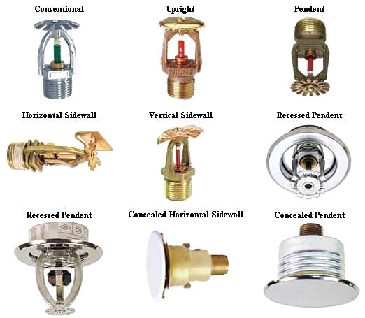
Mounting of sprinkler head

Slide 7
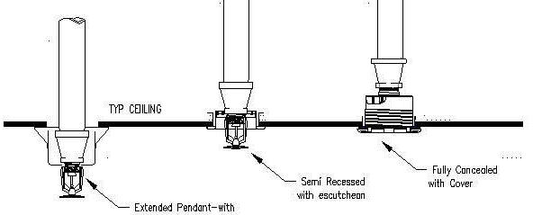
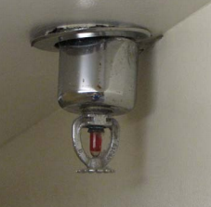
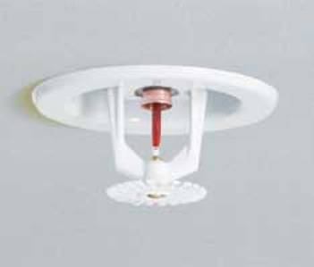
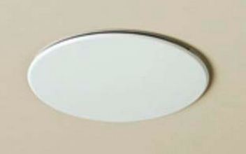
Mounting of Pendent sprinkler

Slide 8
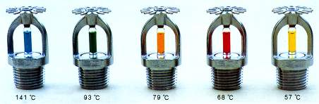
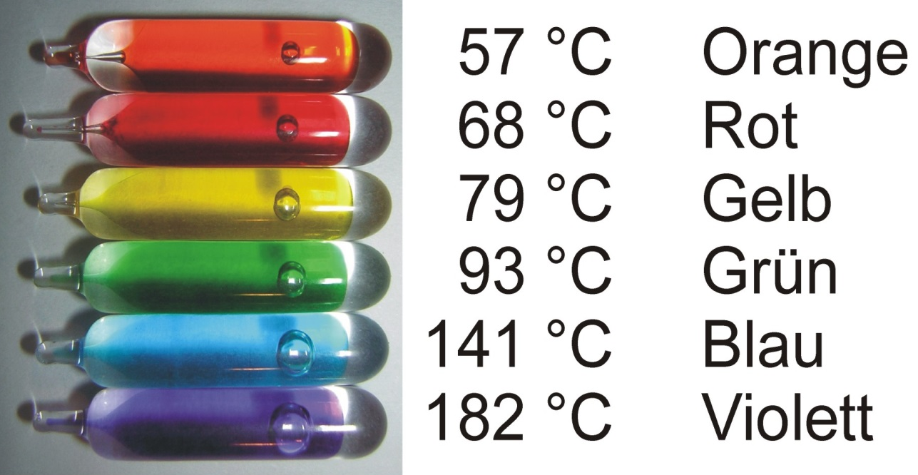
TYPES OF sprinkler bulbs and temperature range
Blue

Slide 9
k-factor
Is factor used to calculate the flow required by sprinkler
Q=K√P
Q : flow in GPM
P : pressure in psi
K : sprinkler
discharge coefficient
Typical K-Factor Values
K 2.8, K 3.0 → Small residential sprinklers
K 5.6 → Standard sprinklers (most common in light/ordinary hazard)
K 8.0, K 11.2 → Larger orifice for warehouses, higher hazard areas
K 14, K 16.8, K 25 → Storage and special applications

Slide 10
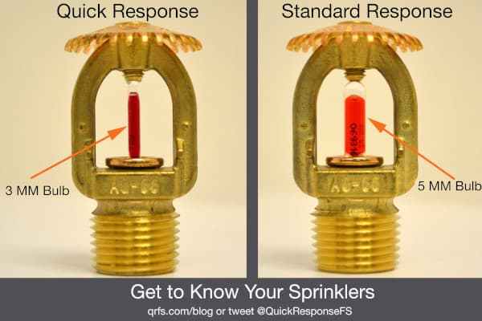
A- Thermal sensitivity
A measure of the rapidity with which the thermal element operates as installed in a sprinkler assembly , one measure of thermal sensitivity is
response time index (RTI)
When RTI = 50 (ms)^{0.5} fast response
When RTI ≥ 80 (ms)^{0.5} standard

Slide 11
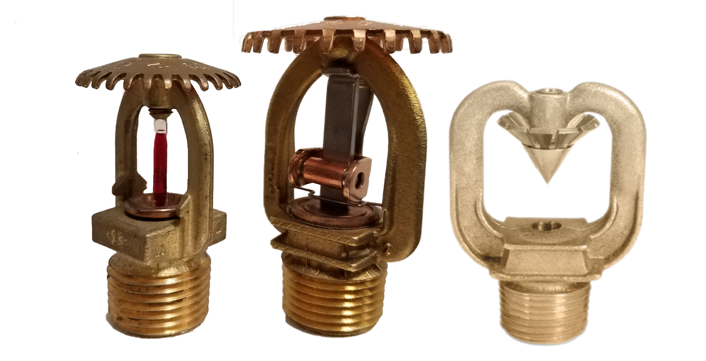
Open Sprinkler & Automatic Sprinkler
No thermal sensing element
At a time Discharge of water in all sprinkler
Supplementary detection system is Needed
Used in high hazard applications
Can not used in areas where water resistant products are stored

Slide 12
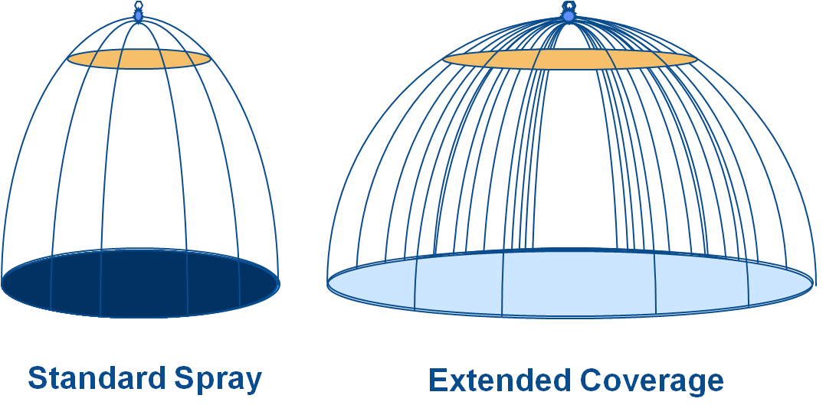
Standard Coverage & Extended Coverage

Slide 13
Fire Hazard Classification Table
Hazard Class | Definition | Typical Examples | Design Density (approx.)
Light Hazard (LH) | Low combustibility, low fuel load, slow fire growth | Offices, schools, hospitals, hotels, churches | 0.10 gpm/ft² (4.1 L/min·m²)
Ordinary Hazard Group 1 (OH-1) | Moderate combustibility, low heat release | Parking garages, laundries, restaurants, mechanical rooms | 0.15 gpm/ft² (6.1 L/min·m²)
Ordinary Hazard Group 2 (OH-2) | Moderate-high combustibility, moderate heat release | Breweries, textile manufacturing, printing, large libraries | 0.20 gpm/ft² (8.1 L/min·m²)
Extra Hazard Group 1 (EH-1) | High combustibility, high heat release, no large flammable liquid use | Rubber manufacturing, saw mills, die-casting shops | 0.30 gpm/ft² (12.2 L/min·m²)
Extra Hazard Group 2 (EH-2) | Severe fire hazard, flammable/combustible liquids present | Paint shops, solvent/varnish plants, chemical plants | 0.40 gpm/ft² (16.3 L/min·m²)

Slide 14
Standard Coverage & Extended Coverage
Hazard Classification | Sprinkler Type | Max. Coverage Area per Sprinkler | Max. Dimensions (L × W) | Typical Min. Pressure | K-Factor Range
Light Hazard | Standard Coverage (SC) | 225 sq. ft. (20.9 m²) | 15 ft. × 15 ft. (4.6 m × 4.6 m) | 7 psi (0.5 bar) | K5.6, K8.0
 | Extended Coverage (EC) | 400 sq. ft. (37.2 m²) | 20 ft. × 20 ft. (6.1 m × 6.1 m) | 15–20 psi (1.0–1.4 bar) | K8.0, K11.2
Ordinary Hazard Group I | Standard Coverage (SC) | 130 sq. ft. (12.1 m²) | 12 ft. × 12 ft. (3.7 m × 3.7 m) | 7 psi (0.5 bar) | K5.6, K8.0
 | Extended Coverage (EC) | 130–196 sq. ft. (12.1–18.2 m²) | Up to 14 ft. × 14 ft. (4.3 m × 4.3 m) | 15–20 psi (1.0–1.4 bar) | K8.0, K11.2
Ordinary Hazard Group II | Standard Coverage (SC) | 130 sq. ft. (12.1 m²) | 12 ft. × 12 ft. (3.7 m × 3.7 m) | 7 psi (0.5 bar) | K5.6, K8.0
 | Extended Coverage (EC) | 196–225 sq. ft. (18.2–20.9 m²) | Up to 15 ft. × 15 ft. (4.6 m × 4.6 m) | 20 psi (1.4 bar) | K8.0, K11.2
Extra Hazard (Gr. I & II) | Standard Coverage (SC) | 100 sq. ft. (9.3 m²) | 10 ft. × 10 ft. (3.0 m × 3.0 m) | 7 psi (0.5 bar) | K8.0, K11.2
 | Extended Coverage (EC) | 144–196 sq. ft. (13.4–18.2 m²) | Up to 14 ft. × 14 ft. (4.3 m × 4.3 m) | 20–30 psi (1.4–2.1 bar) | K11.2, K14.0

Slide 15
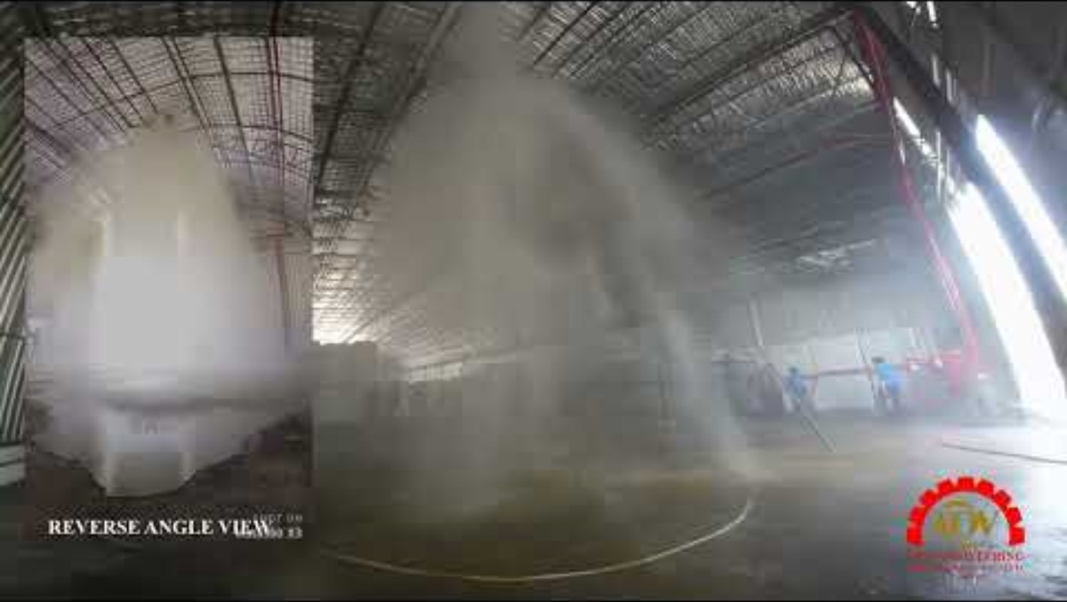

Slide 16
FIRE PROTECTION PIPES
MATERIALS:
Carbon steel pipes(welded or seamless)
Galvanized steel pipe
Copper
HDPE(High-Density Polyethylene)
CPVC pipe(chlorinated polyvinyl chloride)
PEX tubes

Slide 17
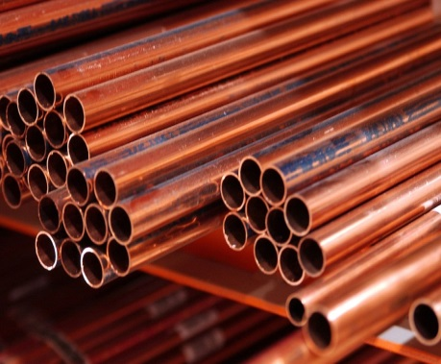
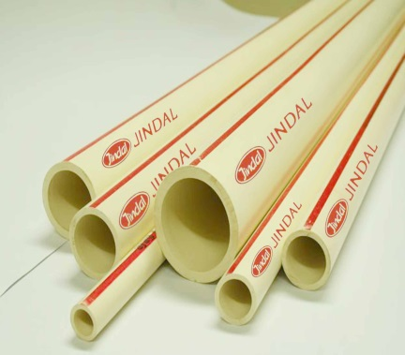
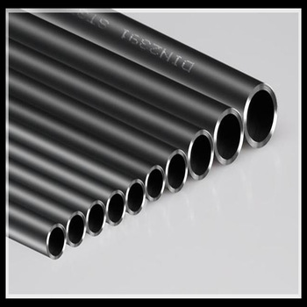
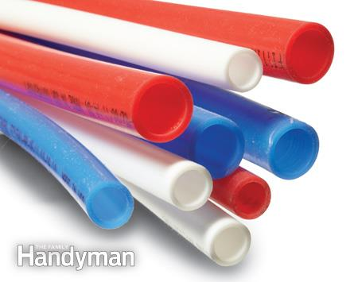
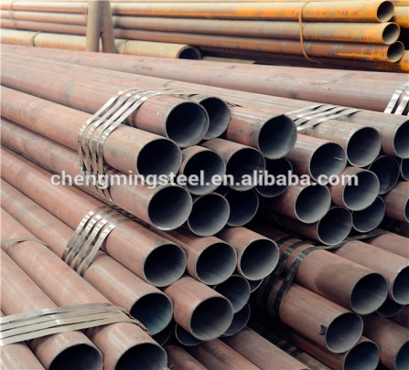
FIRE PROTECTION PIPES
Copper
CPVC
Carbon steel
PEX
Galvanized steel

Slide 18
PIPE FITTINGS
Fire sprinkler systems use specialized fittings made from materials that can withstand high temperatures and pressures in the event of a fire
Threaded fittings – couplings, tees, elbows.
Grooved fittings – fast installation, leak-proof.
Flanged fittings – strong, rigid joints.
Welded fittings – used in high-pressure systems.

Slide 19
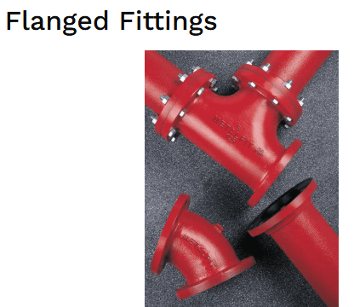
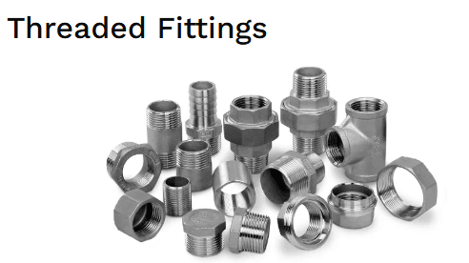
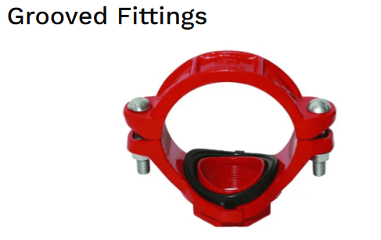
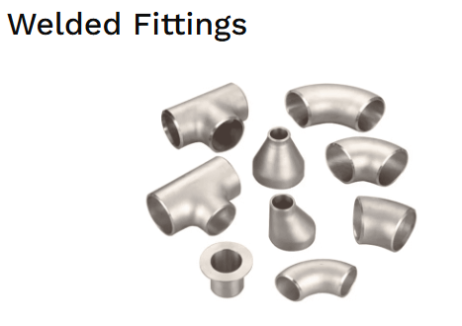
Type of PIPE FITTINGS

Slide 20
Fire PIPE ACCESSORIES
Flow switch
Isolation valve
Ball valve
Butterfly valve
Check valve
Globe valve
Zone Controlling Valve
Regulating Valve

Slide 21
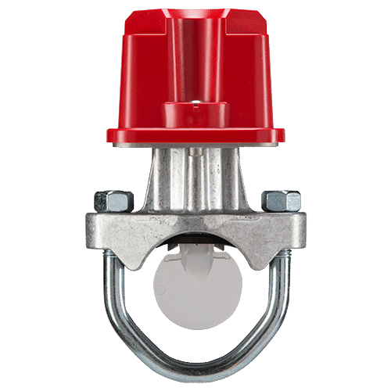
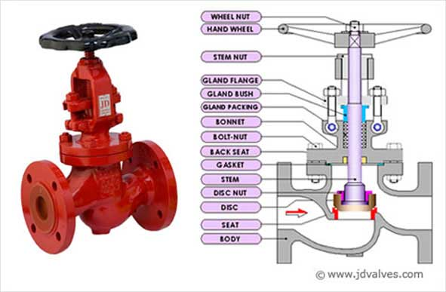
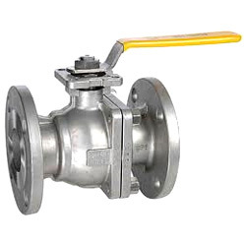
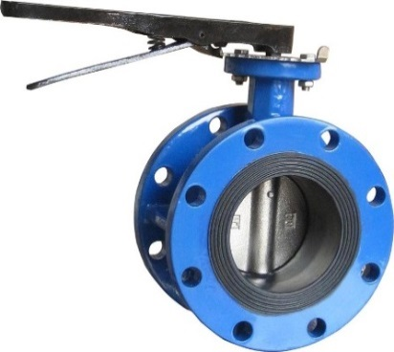
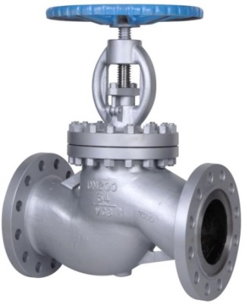
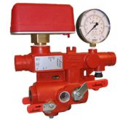
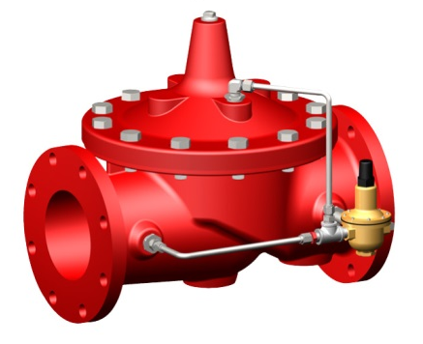
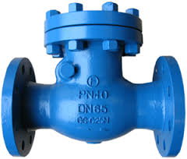
Fire PIPE ACCESSORIES
Flow switch
Isolation valve
Ball valve
Butterfly valve
Check valve
Globe valve
Zone Controlling Valve
Regulating valve

Slide 22
FIRE PROTECTION EQUIPMENTS
FIRE EXTRINGUIESHERS
FIRE HOSE CABINET
SAND BUCKET
FIRE HYDRANTS

Slide 23
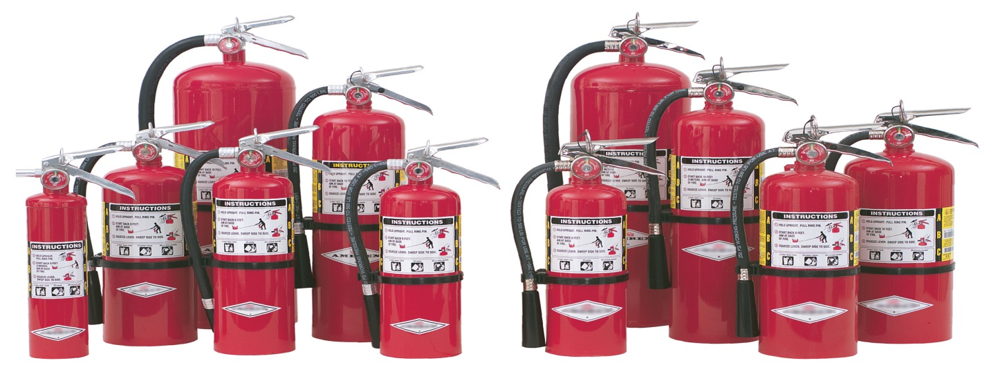
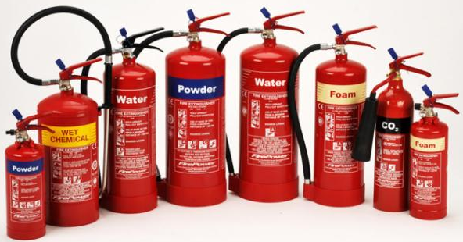
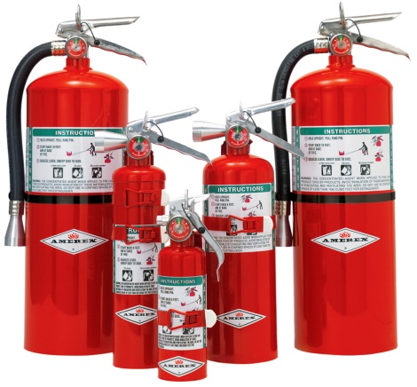
FIRE EXTRINGUIESHERS
FIRE PROTECTION EQUIPMENTS

Slide 24
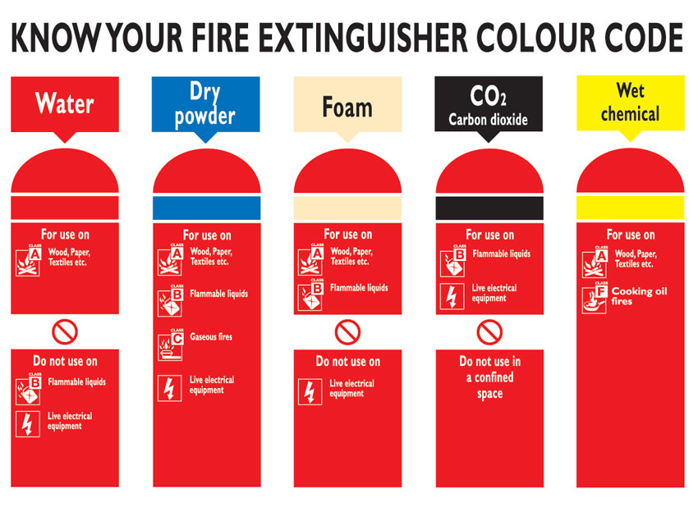
FIRE EXTRINGUIESHERS
FIRE PROTECTION EQUIPMENTS

Slide 25
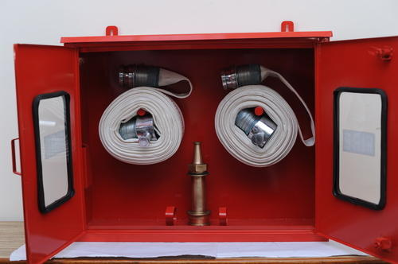
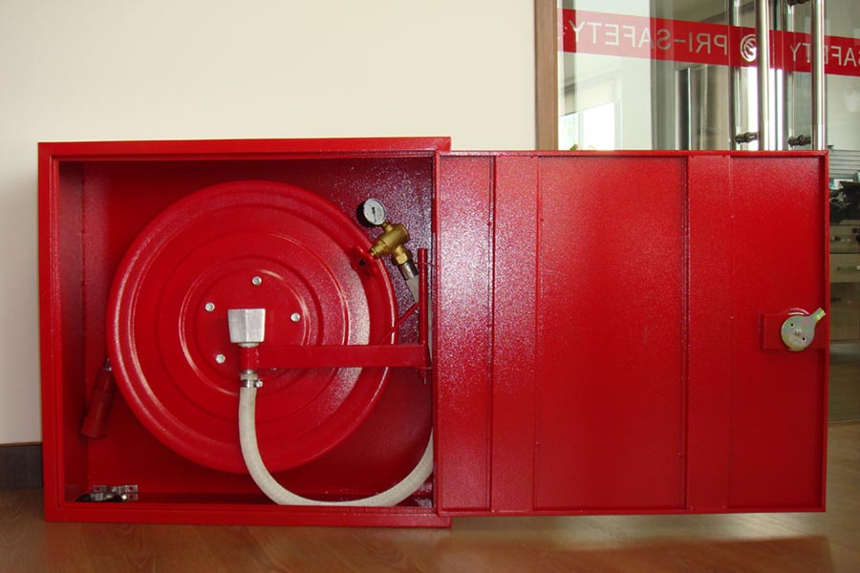
FIRE PROTECTION EQUIPMENTS
Fire hose cabinet
Working fluid : water or other fire retardants, Working pressure : nearly b/w 8 to 10 bar, Bursting pressure : upto 83 bar, Materials : polyster , nylon

Slide 26
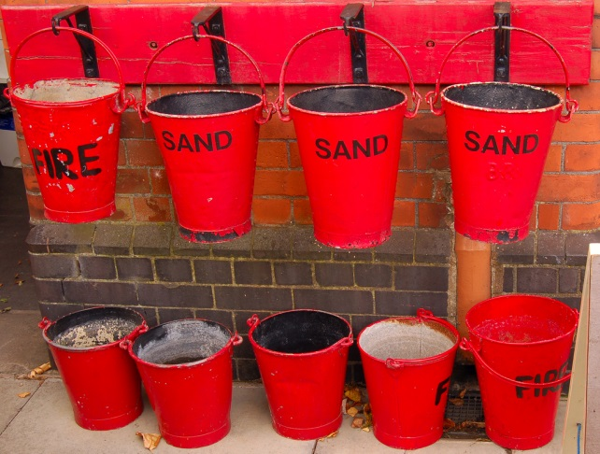
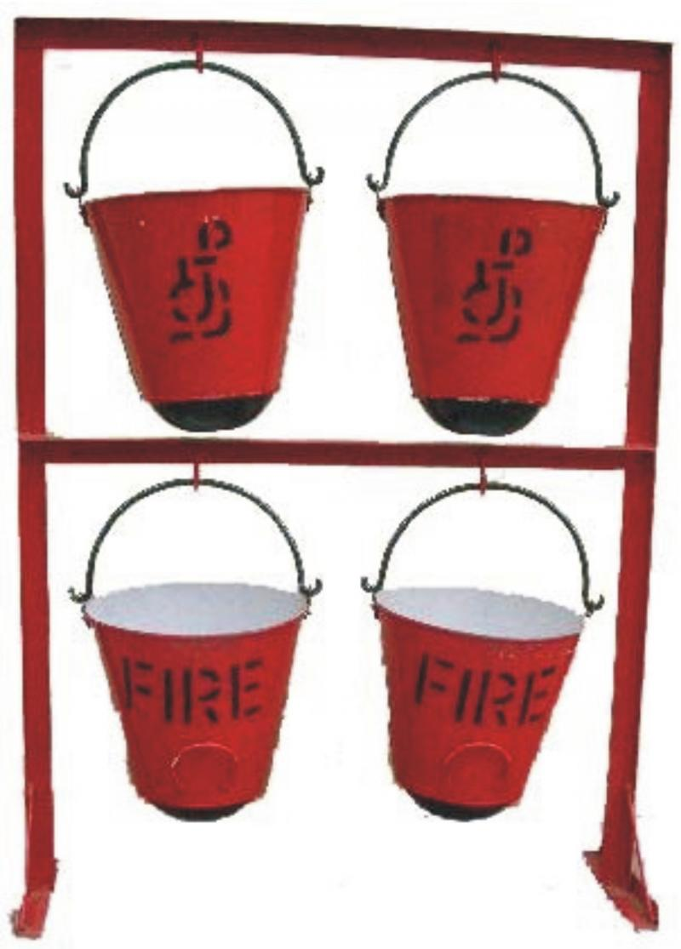
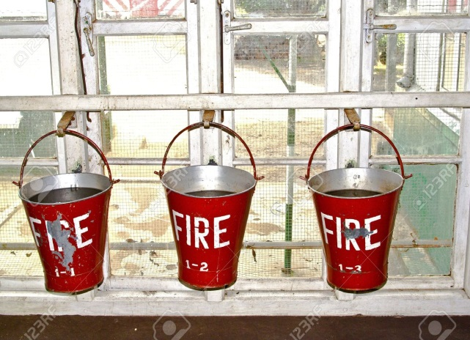
FIRE PROTECTION EQUIPMENTS
SAND BUCKET

Slide 27
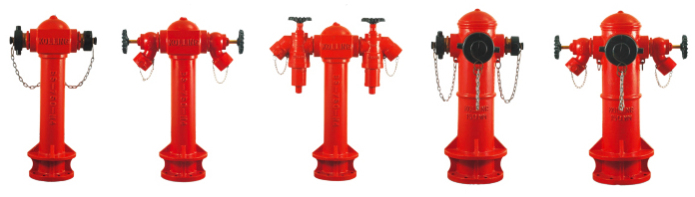
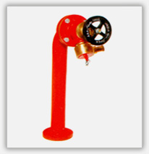
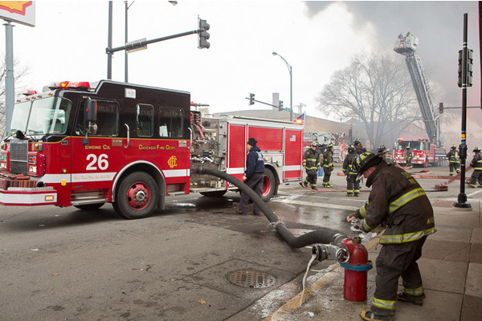
FIRE PROTECTION EQUIPMENTS
FIRE HYDRATES

Slide 28
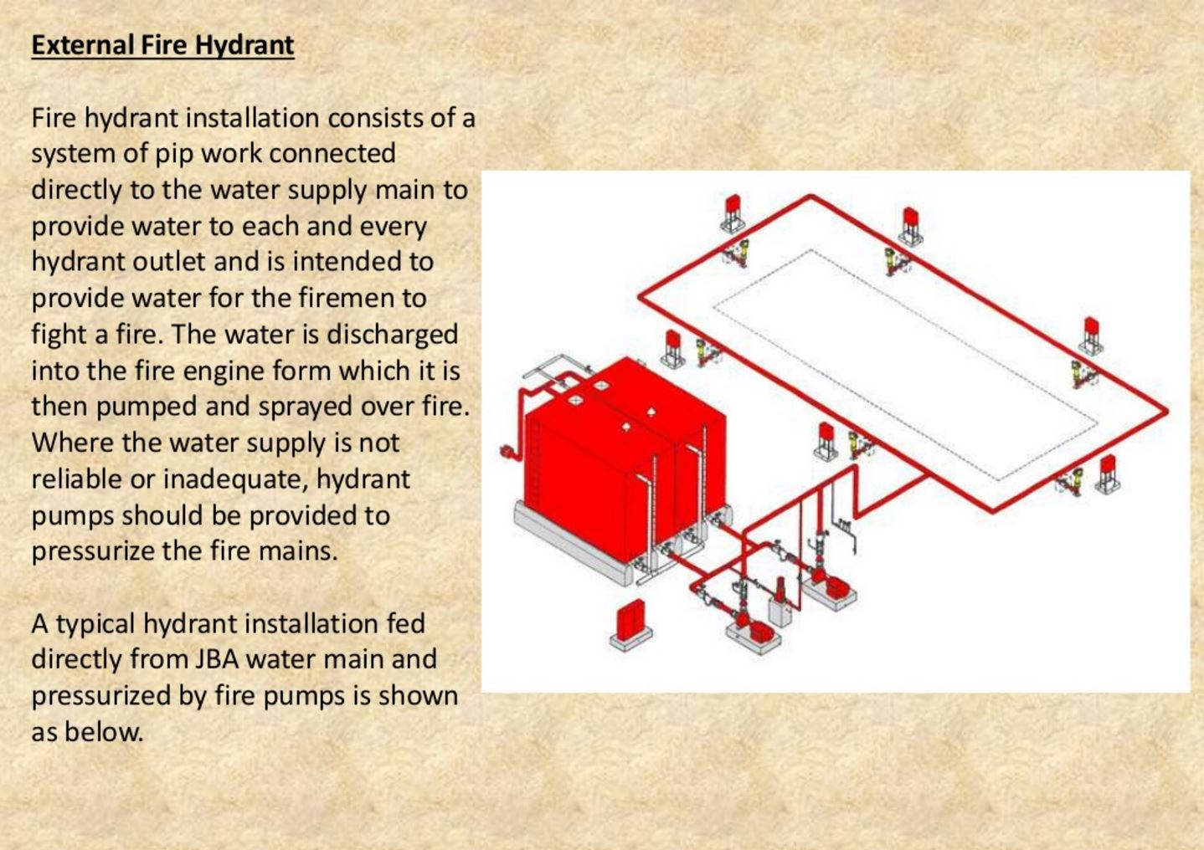
External fire hydrant

Slide 29
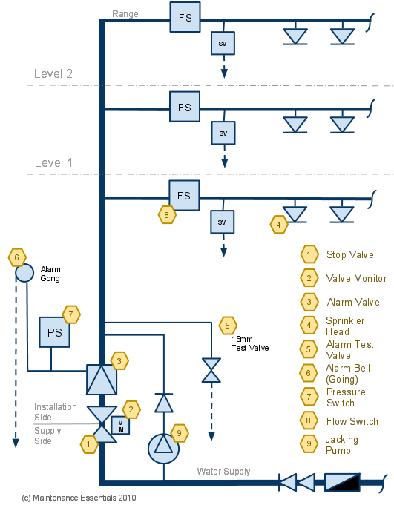
FIRE PROTECTION
SYSTEMS

Slide 30
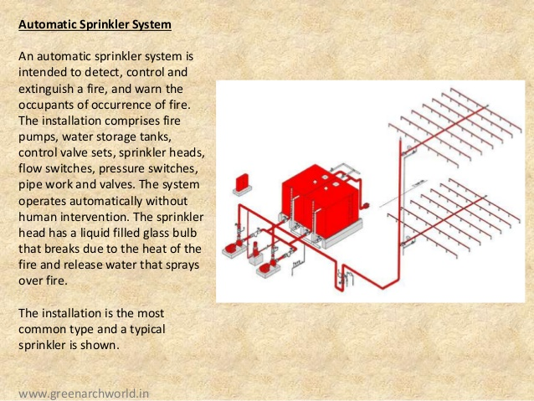
Sprinkler system

Slide 31
TYPE OF FIRE PROTECTION
SYSTEMS
Wet pipe
Dry-pipe
Deluge
Pre-Action

Slide 32
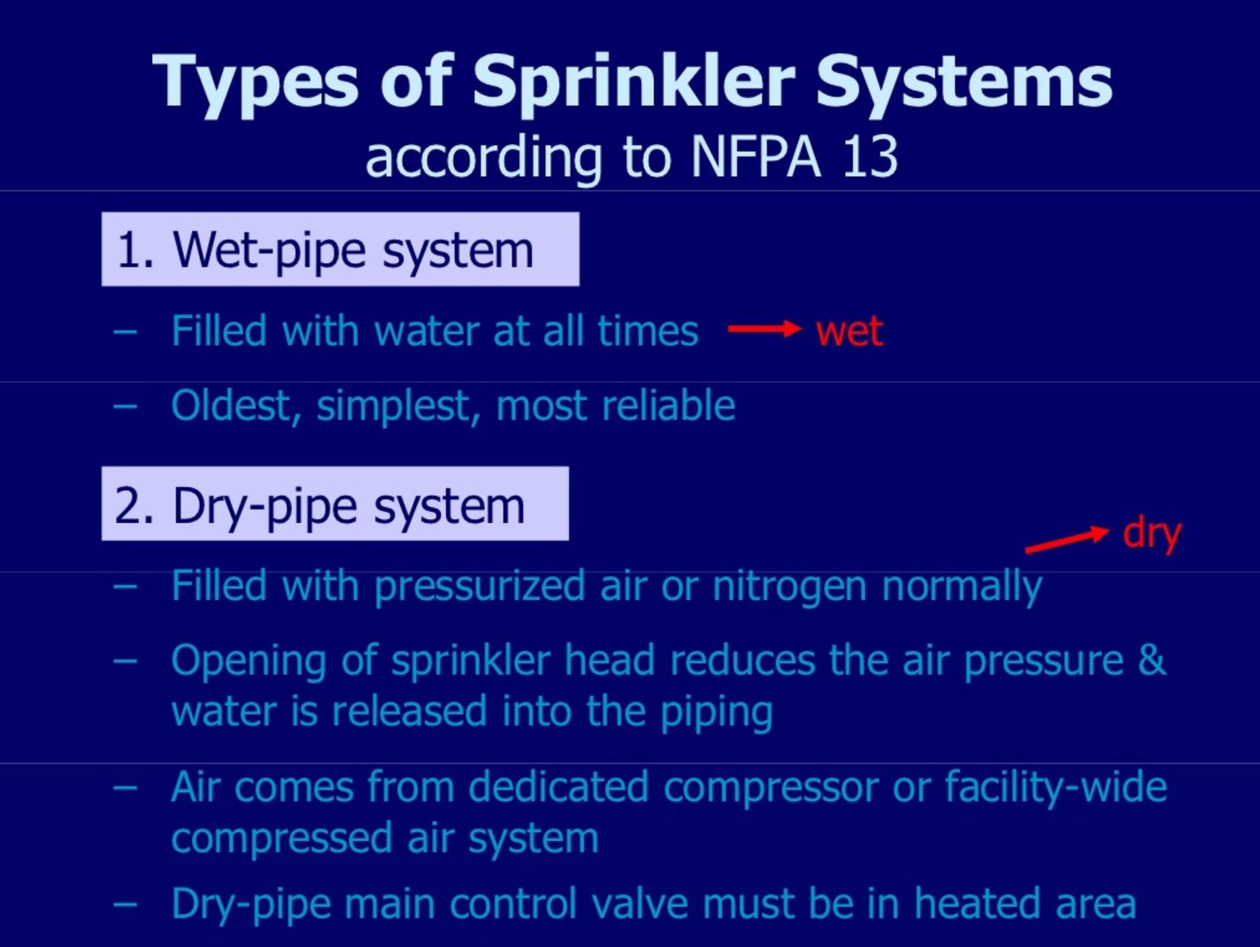
TYPE OF FIRE PROTECTION
SYSTEMS
Wet pipe fire sprinklers constantly have water in them. This allows for a quick reaction to a fire and is the most common type of sprinkler installed in buildings. A type of building that uses the wet pipe system is a high-rise or office building with a few floors. This fire sprinkler system is cost efficient and low maintenance.

Slide 33
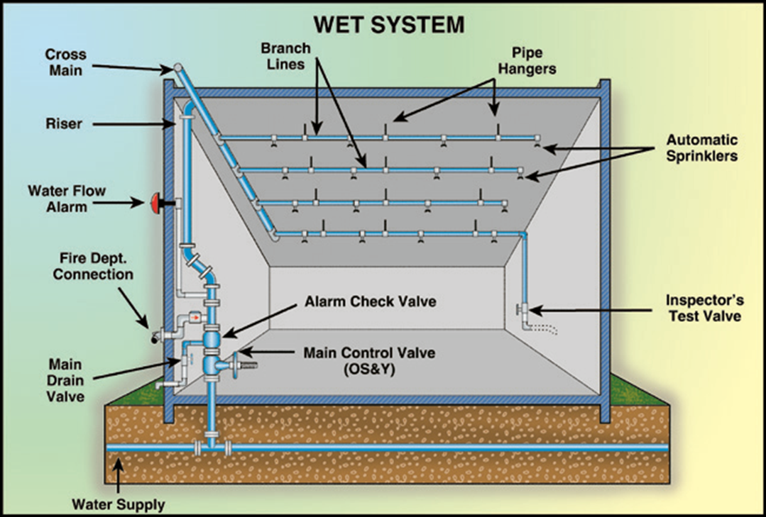
TYPE OF FIRE PROTECTION
SYSTEMS
Wet Pipe System:

Slide 34
TYPE OF FIRE PROTECTION
SYSTEMS

Slide 35
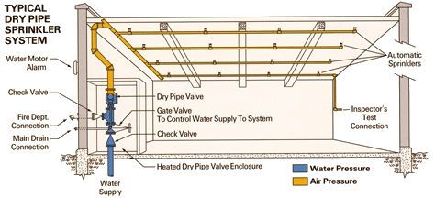
TYPE OF FIRE PROTECTION
SYSTEMS
Dry Pipe System:

Slide 36

TYPE OF FIRE PROTECTION
SYSTEMS

Slide 37

TYPE OF FIRE PROTECTION
SYSTEMS

Slide 38

TYPE OF FIRE PROTECTION
SYSTEMS
Pre-Action System:

Slide 39


Fire protection symbols

Slide 40

floor plan

Slide 41

Schematic diagram

Slide 42

Section drawing

Slide 43

3d model

Slide 44

Conclusion

Slide 45


